Slide 1
Feature Selection

Slide 2
Feature Selection
It is a procedure that is used in machine learning to find a subset of features that produces a good model for the given dataset fulfilling the following requirements:
Avoiding overfitting
Achieving better generalization ability
Reducing storage
Reducing training time

Slide 3
Why Dimensionality Reduction?
It is so easy and convenient to collect data
Data accumulates in an unprecedented speed
Data preprocessing is an important part for effective machine learning and data mining
Most machine learning and data mining techniques may not be effective for high-dimensional data
Curse of Dimensionality
Query accuracy and efficiency degrade rapidly as the dimension increases
The intrinsic dimension may be small.
For example, the number of genes responsible for a certain type of disease may be small.
Dimensionality reduction is an effective approach to downsizing data

Slide 4
Why Dimensionality Reduction?
Visualization: projection of high-dimensional data onto 2D or 3D.
Data compression: efficient storage and retrieval.
Noise removal: positive effect on query accuracy.
Notes:
To improve mining performance
Speed of learning
Predictive accuracy
Simplicity and comprehensibility of mined results

Slide 5
Application of Dimensionality Reduction
Customer relationship management
Text mining
Image retrieval
Microarray data analysis
Protein classification
Face recognition
Handwritten digit recognition
Intrusion detection

Slide 6

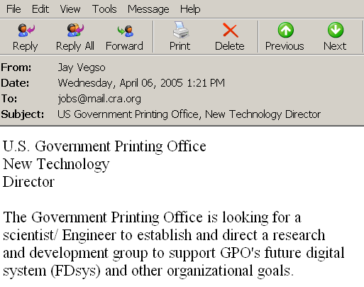


Document Classification
Web Pages
Terms
Emails
T₁ T₂ ….…… T_{N}
C
Sports
12 0 ….…… 6
D₁
3 10 ….…… 28
D₂
Travel
Documents
…
…
…
…
D_{M}
0 11 ….…… 16
Jobs
Internet
Task: To classify unlabeled documents into categories
Challenge: thousands of terms
Solution: to apply dimensionality reduction
ACM Portal
IEEE Xplore
PubMed
Digital Libraries
Notes:
Massive volume of data, categories (sports, travel), normally regarded as a bag of words, c is category, classification task, a moderate sized collection of documents, effects of irrelevant and redundant features, feature selection

Slide 7
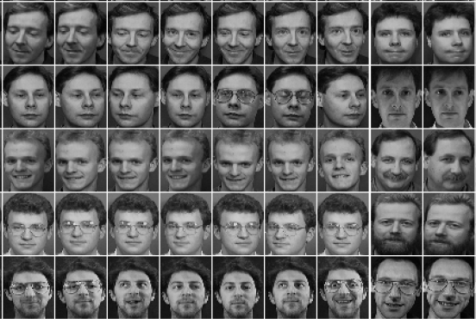
Other Types of High-Dimensional Data
Face images
Handwritten digits

Slide 8
Major Techniques of Dimensionality Reduction
Feature selection
Feature Extraction (reduction)

Slide 9
Feature Selection vs. Feature extraction
Feature selection
A process that chooses an optimal subset of features according to an objective function (Only a subset of the original features are selected)
Feature extraction/reduction
All original features are used
The transformed features are linear combinations of the original features

Slide 10
1. Feature Selection
Feature or Variable Selection refers to the process of selecting features that are used in predicting the target or output.
The purpose of Feature Selection is to select the features that contribute the most to output prediction.
The following line from the abstract of Machine Learning Journal sums up the purpose of Feature Selection.
The objective of variable selection is three-fold: improving the prediction performance of the predictors, providing faster and more cost-effective predictors, and providing a better understanding of the underlying process that generated the data.
Usually these benefits of Feature Selection are quoted :
Reduces overfitting
Improves accuracy
Reduces training time
Notes:
https://www.analyticsvidhya.com/blog/2022/11/feature-selection-101-the-manual-for-beginners/?relatedposts_hit=1&relatedposts_origin=77639&relatedposts_position=2&relatedposts_hit=1&relatedposts_origin=77639&relatedposts_position=2

Slide 11
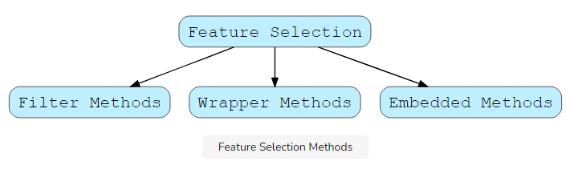
Feature Selection models
Feature Selection Methods are categorized into the following methods.

Slide 12
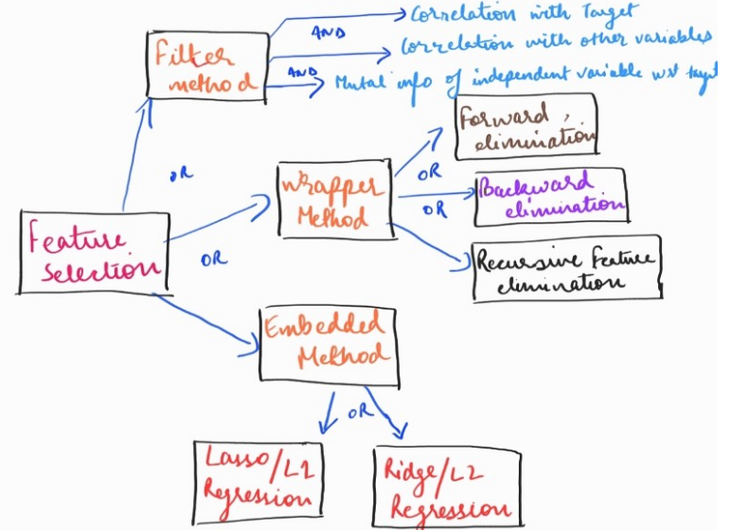
Feature Selection models

Slide 13
a. Filter Method
Filter Methods
The Filter Methods involve selecting features based on their various statistical scores with the output column.
The filter method ranks each feature based on some uni-variate metric and then selects the highest-ranking features.
The selection of features is independent of any Machine Learning algorithm.
The following rules of thumb are as follows:
The more the features are correlated with the output column or the column to be predicted, the better the performance of the model.
Features should be least correlated with each other. If some of the input features are correlated with some additional input features, this situation is known as Multicollinearity. It is recommended to get rid of such a situation for better performance of the model.

Slide 14
a. Filter Method
Filter Selection Select independent features with:
No constant Variables
No/less Quasi-constant variables
No Duplicate Rows
High correlation with the target variable
Low correlation with another independent variable
Higher information gain or mutual information of the independent variable.
mRMR Score:
Selecting an optimal feature subset from a large feature space is considered challenging problem.
The mRMR (Minimum Redundancy and Maximum Relevance) feature selection framework solves this problem by selecting the relevant features while controlling for the redundancy within the selected features.
mRMR feature selection method is used for different classification problem such as marketing machine learning platform at Uber that automates creation and deployment of targeting and personalization models at scale
Notes:
Quasi means partially or close to

Slide 15
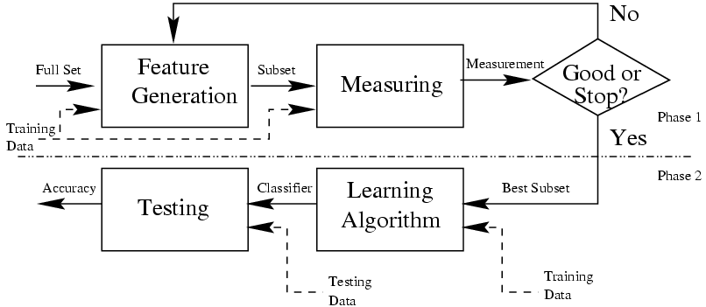
a. Filter Method

Slide 16
a. Filter Method
Removing features with low variance(Low variance filter)
Variance Threshold is a simple baseline approach to Feature Selection.
It removes all features whose variance doesn’t meet some threshold.
This involves removing the features having the same value (zero-variance features) in all of their rows or to a specified number of rows.
Such features provide no value in building the machine learning predictive model.

Slide 17
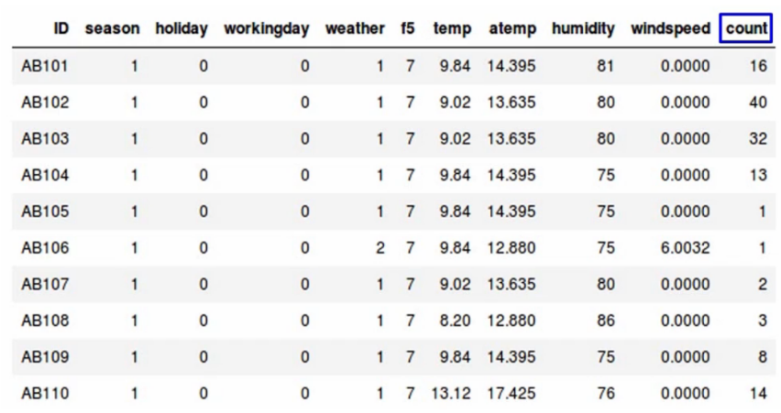
Example: rental bikes predict the count of bikes that have been rented-
Notes:
season - 1 = spring, 2 = summer, 3 = fall, 4 = winter holiday - whether the day is considered a holiday workingday - whether the day is neither a weekend nor holiday weather - 1: Clear, Few clouds, Partly cloudy, Partly cloudy 2: Mist + Cloudy, Mist + Broken clouds, Mist + Few clouds, Mist 3: Light Snow, Light Rain + Thunderstorm + Scattered clouds, Light Rain + Scattered clouds 4: Heavy Rain + Ice Pallets + Thunderstorm + Mist, Snow + Fog temp - temperature in Celsius atemp - "feels like" temperature in Celsius humidity - relative humidity windspeed - wind speed count - number of total rentals

Slide 18
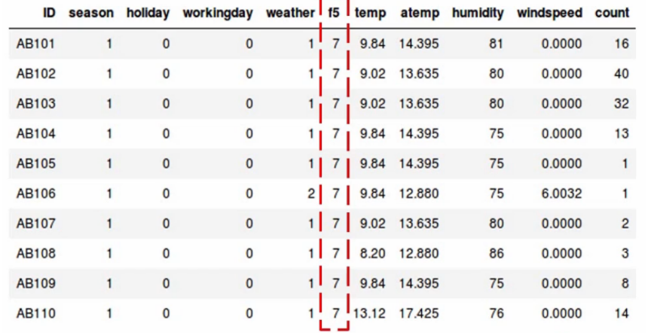
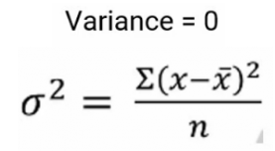
Example contd.
Notes:
Variance tells us about the spread of the data. It tells us how far the points are from the mean.
and the formula to calculate variance is given here-
https://www.analyticsvidhya.com/blog/2021/04/beginners-guide-to-low-variance-filter-and-its-implementation/

Slide 19
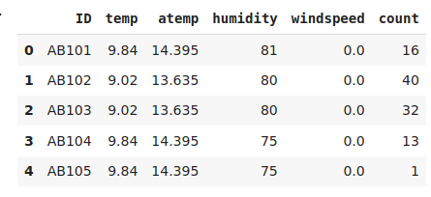
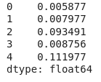
Example: rental bikes
Target variable: count of bikes
Total 6 variables or columns
First drop the ID variable
Apply the low variance filter and try to reduce the dimensionality of the data.
Normalize the data
Compute the variance
Set variance threshold
Select features have Variance greater than set threshold
Threshold>=0.006
Notes:
Normalize the variables because variance is range dependent
As we can see in our dataset, the variables have a pretty high range, which will skew our results

Slide 20
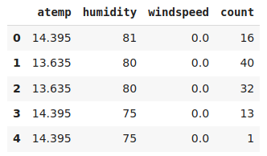
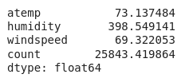
Example: rental bikes
4. Select features have Variance greater than set threshold

Slide 21
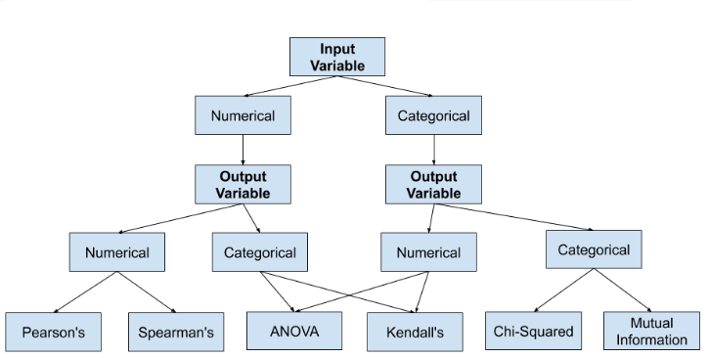
How to choose a feature selection method?

Slide 22
B. Pearson’s correlation coefficient
Pearson Correlation
A Pearson correlation is a number between -1 and 1 that indicates the extent to which two variables are linearly related.
The Pearson correlation is also known as the “product moment correlation coefficient” (PMCC) or simply “correlation”
Pearson correlations are suitable only for metric variables
The correlation coefficient has values between -1 to 1
A value closer to 0 implies weaker correlation (exact 0 implying no correlation)
A value closer to 1 implies stronger positive correlation
A value closer to -1 implies stronger negative correlation

Slide 23
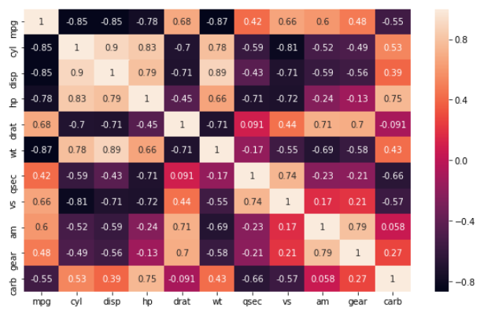
Mpg data set: heat map
It is seen that the variables cyl and disp are highly correlated with each other (0.902033).
Hence we compared with target variable where target variable mpg is highly correlated with cyl hence would keep and drop the other.
Then we check with other variable same process is followed until last variable.
we are left with four features wt, qsec, gear, carb.
These are the final features given by Pearson correlation.
Multicolineartity: Variance inflation factor(VIF)

Slide 24
B. Pearson’s correlation coefficient
Example: A researcher in a scientific foundation wished to evaluate the relation between annuals salaries of mathematicians (Y, in thousand dollars) and an index of work quality (X1), number of years of experience (X2), and an index of publication success (X3)
index of work quality (X1) | number of years of experience (X2) | index of publication success (X3) | annual salaries (in thousand dollars Y)
3.5 | 9 | 6.1 | 33.2
5.1 | 18 | 7.4 | 38.7
6 | 13 | 5.9 | 37.5
3.1 | 5 | 5.8 | 30.1
4.5 | 25 | 5 | 38.2
Find the correlation Matrix for given data set

Slide 25
Example: cont.

Slide 26
C. Mutual Information (Information Gain)
Information gain as a measure of how much information a feature provides about a class.
The feature having the most information is considered important by the algorithm and is used for training the model.
The effort is to reduce the entropy and maximize the information gain.
Information gain helps to determine the order of attributes in the nodes of a decision tree.
Information gain is used in decision trees and random forest to decide the best split.

Slide 27
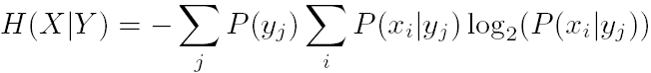
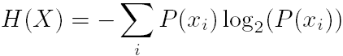
C. Mutual Information
A more robust approach would be to use Mutual Information, which can be thought as the reduction in uncertainty about one random variable given knowledge of another.
Entropy of variable X
Entropy of X after observing Y
Information Gain
Used when you need a normalized measure of information gain (between 0 and 1
Notes:
p1=portion of the data set that include positive examples
p0=portion of the data set that include negative examples
Entropy(D) is just the average amount of information needed to identify
the class label of a tuple in D

Slide 28
Entropy
Entropy is an information theory metric that measures the impurity or uncertainty in a group of observations.
Entropy is uncertainty/ randomness in the data, the more the randomness the higher will be the entropy. Information gain uses entropy to make decisions.
If the entropy is less, information will be more.
Higher entropy implies greater uncertainty or lack of predictability.
Notes:
IG=Entropy(Parent)-weighted_avg*Entropy(children)
Shannon(1948) used the concept of entropy for the theory of communication,
to determine how to send encoded (bits) information from a sender to a receiver without loss of information
and with the minimum amount of bits.

Slide 29
ENTROPY
Notes:
Info(D) is just the average amount of information needed to identify
the class label of a tuple in D
Entropy, in general, measures the amount of disorder or uncertainty in a system. In the
classification setting, a partition has lower entropy (or low disorder) if it is relatively
pure, that is, if most of the points have the same label. On the other hand, a partition
has higher entropy (or more disorder) if the class labels are mixed, and there is no
majority class as such.

Slide 30
Example#1:

Slide 31
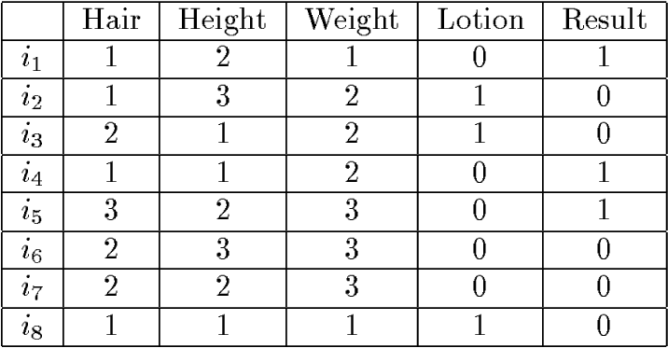
Example#2: Illustrative Data Set
Sunburn data
Ex: Which attribute has the highest info gain for the data?

Slide 32
Filter Method
Univariate Selection Methods
Univariate Feature Selection methods selects the best features based on Univariate Statistical tests. Scikit Learn provides the following methods in the Univariate Feature Selection methods.
SelectKBest
SelectPercentile
These two above are the most commonly used methods.

Slide 33
Filter Method
Advantages of Filter methods
Filter methods are model agnostic(compatible)
Rely entirely on features in the dataset
Computationally very fast
Based on different statistical methods
The disadvantage of Filter methods
The filter method looks at individual features for identifying it’s relative importance. A feature may not be useful on its own but may be an important influencer when combined with other features. Filter methods may miss such features.
One thing that should be kept in mind is that the filter method does not remove multicollinearity. So, you must deal with the multicollinearity of features as well before training models for your data.

Slide 34
2. Wrapper Methods (Feature Selection)
Wrapper Methods: In Wrapper Methods the problem of Feature Selection is reduced to a search problem.
A model is built using a set of features and its accuracy is recorded.
Based on the accuracy, more features are added or removed, and the process is repeated.

Slide 35
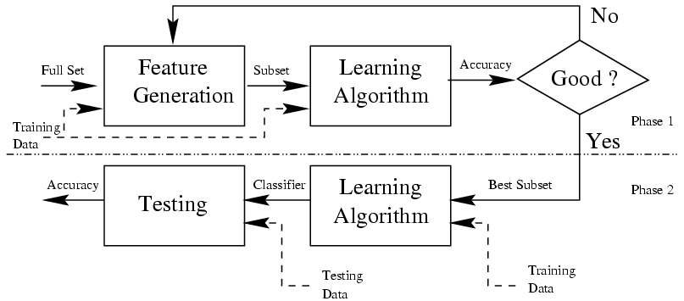
2. Wrapper Methods (Feature Selection)

Slide 36
2. Wrapper Methods (Feature Selection)
We have the following methods in Wrapper Methods.
Forward Selection
Backward Elimination
Exhaustive Search
Recursive Feature Elimination

Slide 37
Wrapper Methods
A. Forward Selection
Forward Selection is an iterative method.
In this method, we start with one feature and we keep on adding features until no improvement in the model is observed.
The search is stopped after a pre-set criteria is met.
This is a greedy approach because it always targets the features in a forward fashion, which gives a boost to the performance.
If the number of features are large, it can be computationally expensive.
B. Backward Elimination
This process is the opposite of the Forward Selection Method.
It starts initially with all the features and keeps on removing features until no improvement is observed.

Slide 38
Feature Selection : Wrapper Methods
C. Exhaustive Search
This Feature Selection Method tries all the possible combinations of features to select the best model.
This method is quite computationally expensive.
For example, if we have five features, we will be evaluating 2^5 = 3225=32 models before finalizing a model with good accuracy.
D. Recursive Feature Elimination
Recursively Feature Elimination (RFE) involves the following steps:
We train the model on the initial set of features and the importance of each feature is calculated.
In the second iteration, a model is built again using the most important features and excluding the least important features.
These steps are repeated recursively until we are left with the most important features for the problem under consideration.
Scikit learn library provides functions for Recursive Feature Elimination.

Slide 39
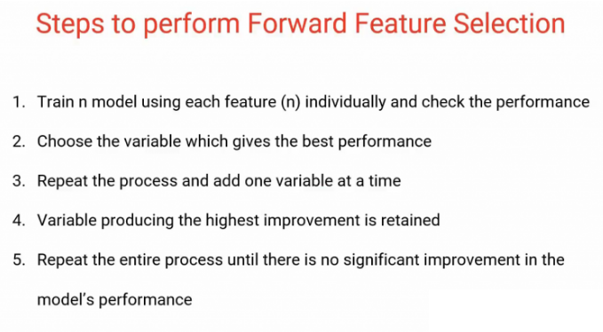
Wrapper method: Forward feature selection

Slide 40
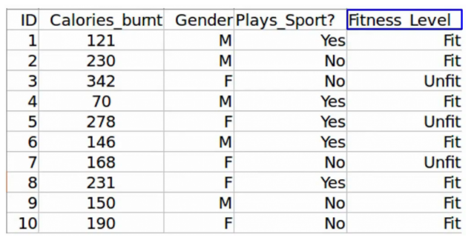
Wrapper based model: forward feature selection
Fitness level prediction
So the first step in Forward Feature Selection is to train n models using each feature individually and checking the performance.
If you have three independent variables, we will train three models using each of these three features individually.

Slide 41
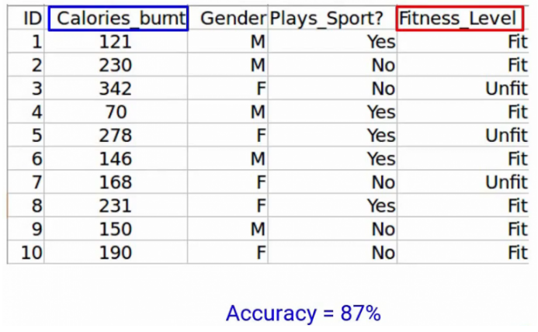
forward feature selection: Example
Let’s say we trained the model using the Calories_Burnt feature and the target variable, Fitness_Level and we’ve got an accuracy of 87%
Notes:
https://www.analyticsvidhya.com/blog/2021/04/forward-feature-selection-and-its-implementation/

Slide 42
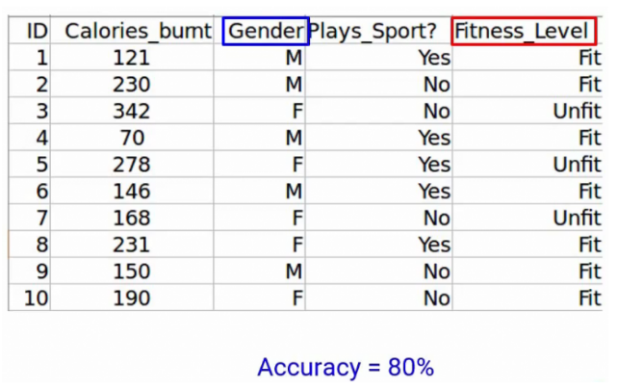
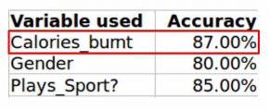
forward feature selection: Example cont.
Next, we’ll train the model using the Gender feature, and we get an accuracy of 80%

Slide 43
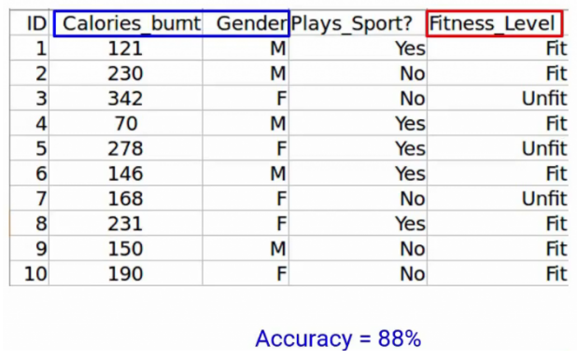
Example cont.
Next, we will repeat this process and add one variable at a time. So of course we’ll keep the Calories_Burnt variable and keep adding one variable. So let’s take Gender here and using this we get an accuracy of 88%-

Slide 44
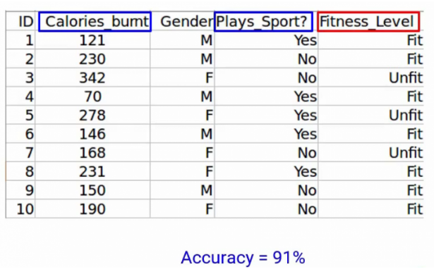
Example cont
Plays_Sport along with Calories_Burnt, we get an accuracy of 91%. A variable that produces the highest improvement will be retained.

Slide 45
Feature Selection (Wrapper model): Backward Feature Elimination
These are our assumptions-
No missing values in the dataset
Variance of the variables is high
Low correlation between the independent variables

Slide 46
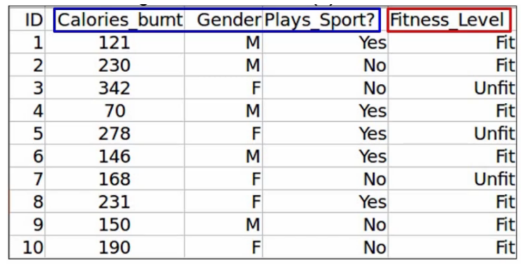
Backward Feature Elimination: Example
Fitness prediction level
The first step is to train the model, using all the variables.
You’ll of course not take the ID variable train the model as ID contains a unique value for each observation
So we’ll first train the model using the other three independent variables. And of course, the target variable, which is the Fitness_Level.
we get an accuracy of 92% using all three independent variables.

Slide 47
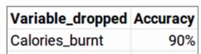
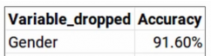
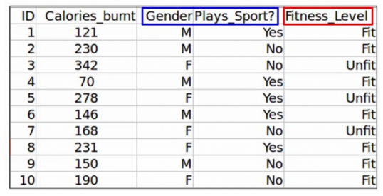
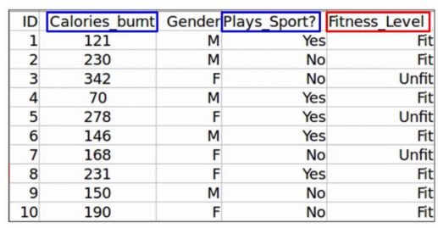
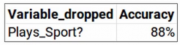
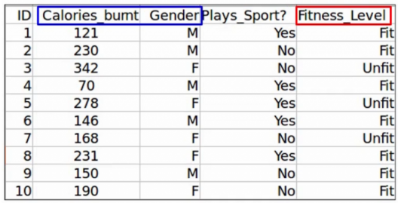

Slide 48
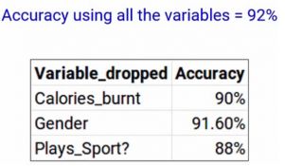
Backward Feature Elimination: Example
If you see gender has produced the smallest change in the performance in the model first, it was 92% when we took all the variables and when we dropped gender, it was 91.6%. So we can infer that gender does not have a high impact on the Fitness_Level variable. And hence it can be dropped.
Finally, we will repeat all these steps until no more variables can be dropped.
It’s a very simple, but very effective technique.

Slide 49
3.Intrinsic Methods (Feature Selection)
Intrinsic or Embedded Methods
Embedded methods learn about the features that contribute the most to the model’s performance while the model is being created. You have seen Feature Selection methods in the previous lessons, and we will discuss several more in future lessons, like Decision Tree based methods.
Ridge Regression (L2-Regularization)
Lasso Regression (L1-Regularization)
Elastic-Net Regression (uses both L1 and L2 Regularization)
Decision Tree-Based Methods (Decision Tree Classification, Random Forest Classification, XgBoost Classification, LightGBM).
Notes:
We know regularization reduces some of the parameters in the equation below to zero. This property of regularization methods can be used as a Feature Selection Method.
y = w_0 + x_1w_1 + x_2w_2 + x_3w_3... +x_nw_ny=w0​+x1​w1​+x2​w2​+x3​w3​...+xn​wn​

Slide 50
Variance Inflation Factor(VIF)
Multicollinearity is a statistical phenomenon that occurs when two or more independent variables in a regression model are highly correlated with each other
It is challenging in the regression analysis because it becomes difficult to determine the individual effects of each independent variable on the dependent variable accurately
VIF determines the strength of the correlation between the independent variables
VIF score of an independent variable represents how well the variable is explained by other independent variables
Notes:
https://machinelearningmastery.com/feature-selection-with-real-and-categorical-data/
https://medium.com/mlearning-ai/feature-selection-using-filter-method-python-implementation-from-scratch-375d86389003

Slide 51
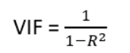
VIF
VIF Range is 1 to ∞
VIF = 1, no correlation between the independent variable and the other variables
VIF between 1 and 5 = variables are moderately correlated
VIF greater than 5 = variables are highly correlated
VIF exceeding 10 indicates significant multicollinearity that needs to be corrected

Slide 52
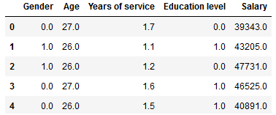
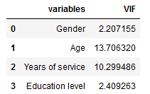
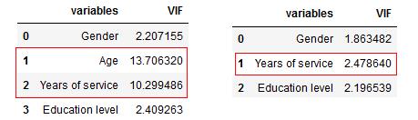
Example

Slide 53
One method to detect multicollinearity is to calculate the variance inflation factor (VIF) for each independent variable
To fix multicollinearity, one can remove one of the highly correlated variables, combine them into a single variable, or use a dimensionality reduction technique such as principal component analysis (PCA) to reduce the number of variables while retaining most of the information.

